Slide 1
Customer Segmentation

Slide 2
Objectives
To categorize customers into distinct segments based on their personalities, behaviors, preferences, and purchasing patterns. This helps in tailoring marketing strategies to each segment effectively.
To categorize customers into distinct segments or clusters based on their personalities, behaviors, preferences, and purchasing patterns.
To understand the underlying motivations and preferences of different customer personalities to personalize interactions, products, and services, thereby improving overall customer satisfaction and loyalty.
To predict the new customer’s segment or cluster based on their data in order to recommend the product based on the related cluster of the customer.

Slide 3
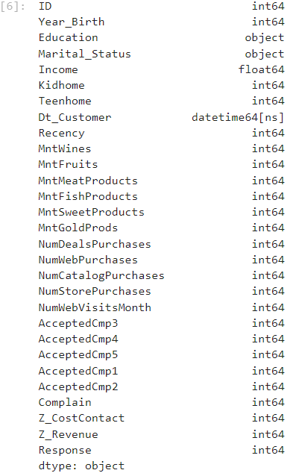
Understanding the data
There are total 27 features available in the dataset in which 24 features are numerical data type, 2 features are of categorical data type and 1 feature is of datetime data type.
‘Income’ feature has some missing values which will be taken care of in data cleaning.

Slide 4
Feature engineering and data cleaning
Created 3 new features from existing features.
Created ‘TotalSpent’ feature by combining the amount spent on features like ‘MntWines’, 'MntFruits', 'MntMeatProducts', 'MntFishProducts', 'MntSweetProducts', 'MntGoldProds’.
The second feature created is Age of the customer by using the ‘year_birth’ feature.
The third feature created is ‘TotalKids’ by adding the ‘Kidhome’ and ‘TeenHome’ .
For data cleaning part I filled the missing values of ‘Income’ by using the mean value.
Corrected the data type of ‘Dt_customer’.
Then I used one-hot encoding on categorical data and deleted some use-less columns such as ID, Z_Revenue, etc. so that it becomes easier to scale the data.

Slide 5
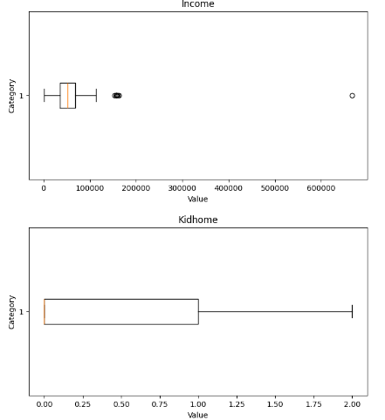
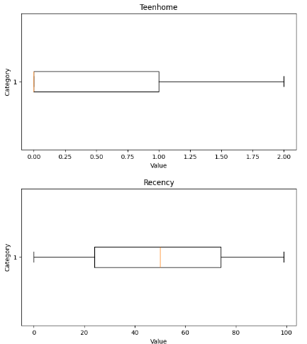
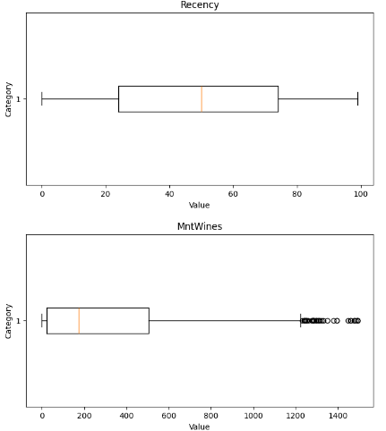
EDA
Detecting Outliers using Boxplot
Many features were found with outliers such as ‘Income’, ’MntWines’, ‘MntFruits’, etc.
These are some Boxplot visuals to see outliers.

Slide 6
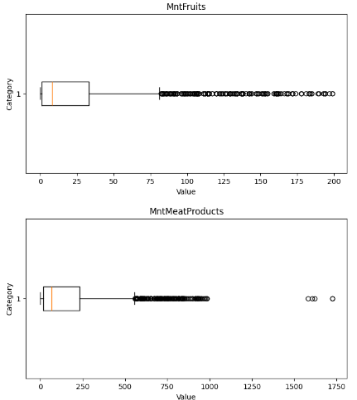
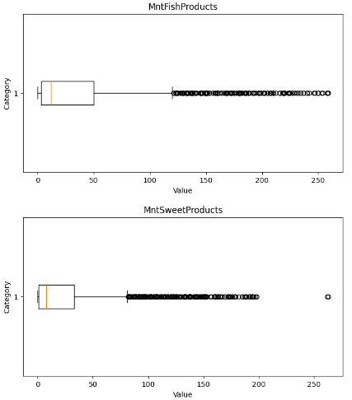
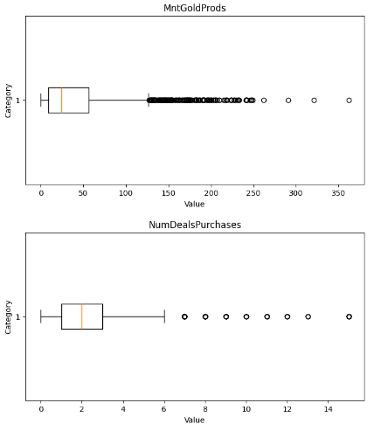
Detecting Outliers using Boxplot

Slide 7
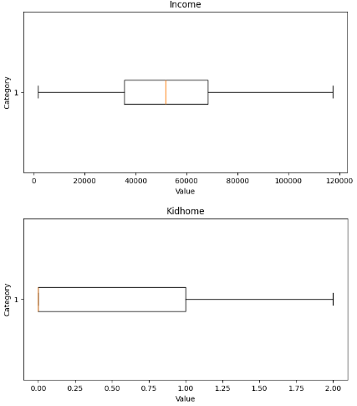
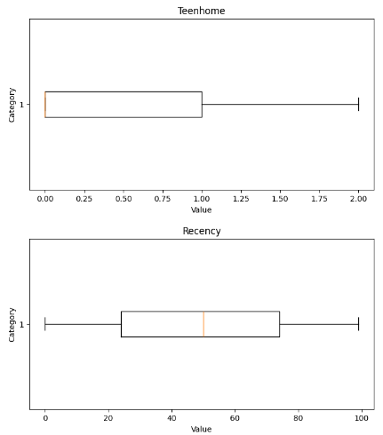
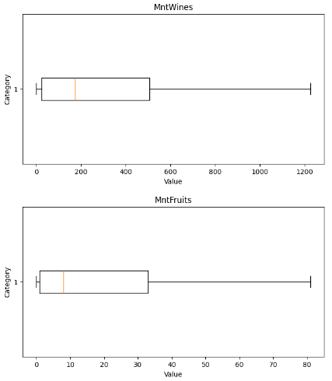
Capping Outliers using iqr technique and visualising it using boxplot

Slide 8
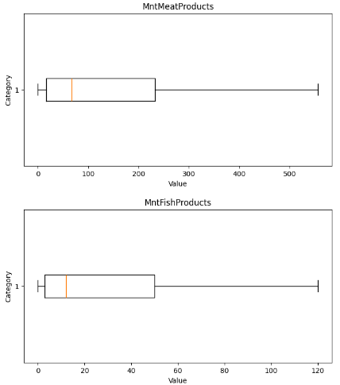
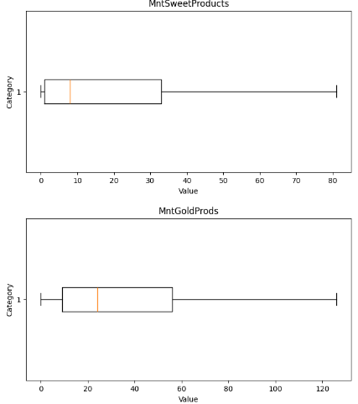
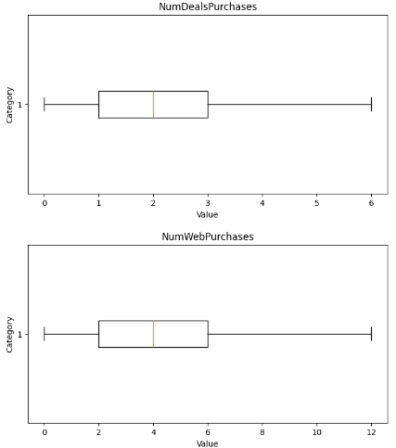
Capping Outliers using iqr technique and visualising it using boxplot

Slide 9
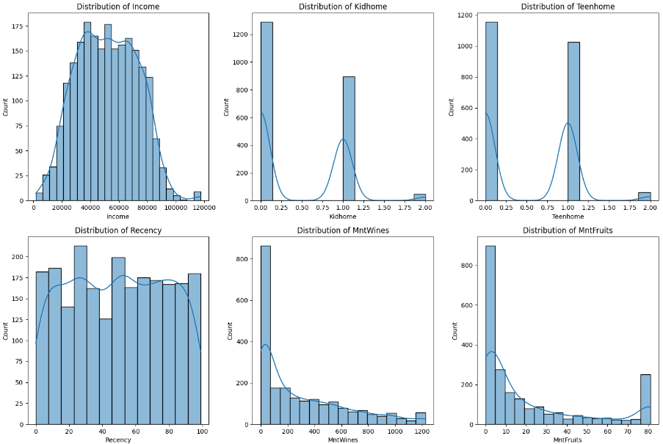
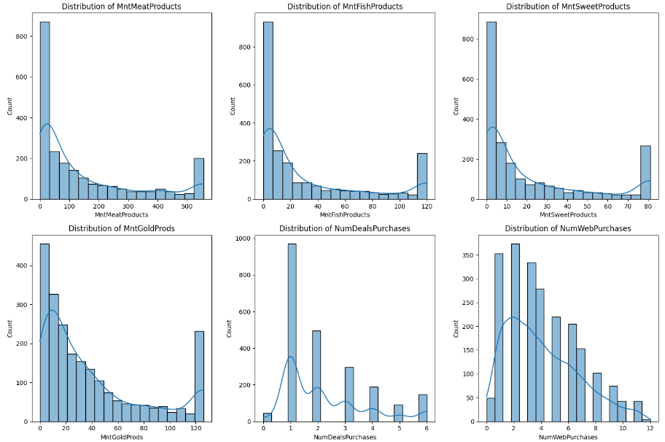
Univariate analysis :- Visualising the distribution of the data

Slide 10
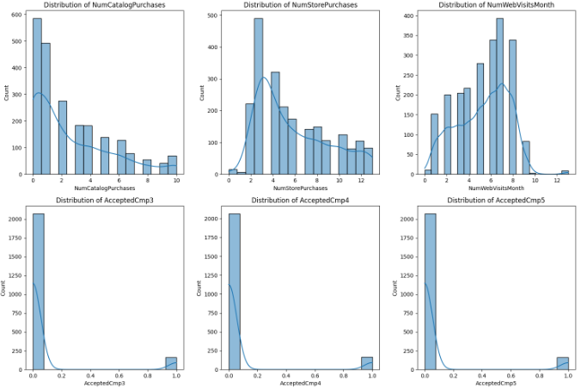
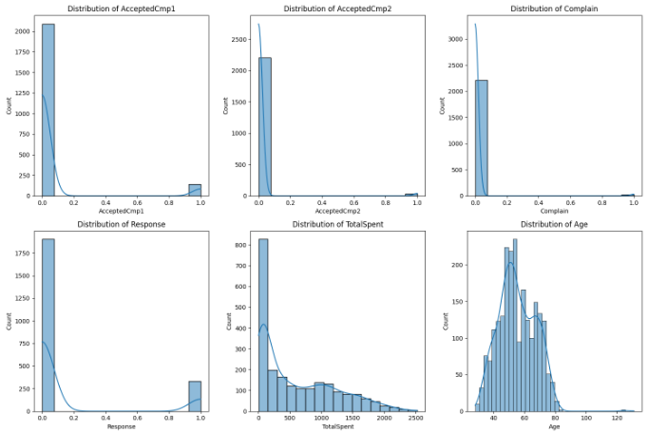

Slide 11
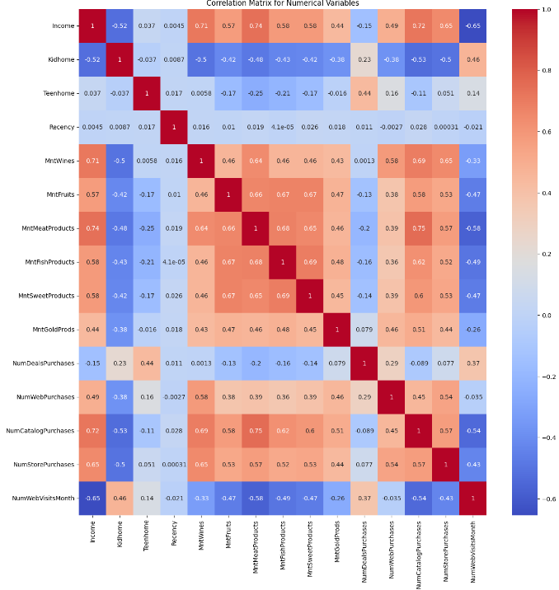
Bivariate analysis : Correlation matrix for Numerical variables

Slide 12
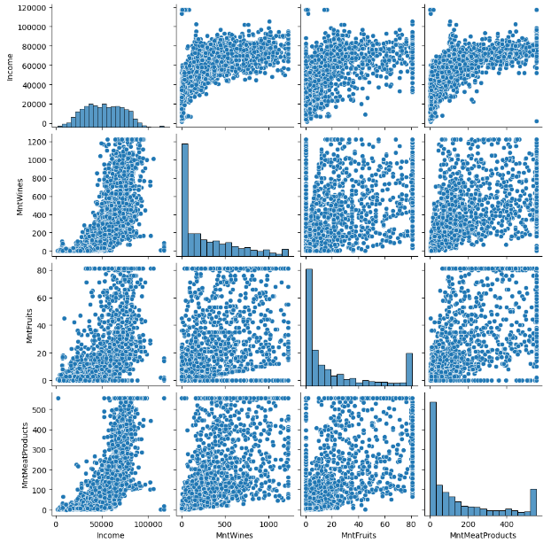
Visualisation of pairplot

Slide 13
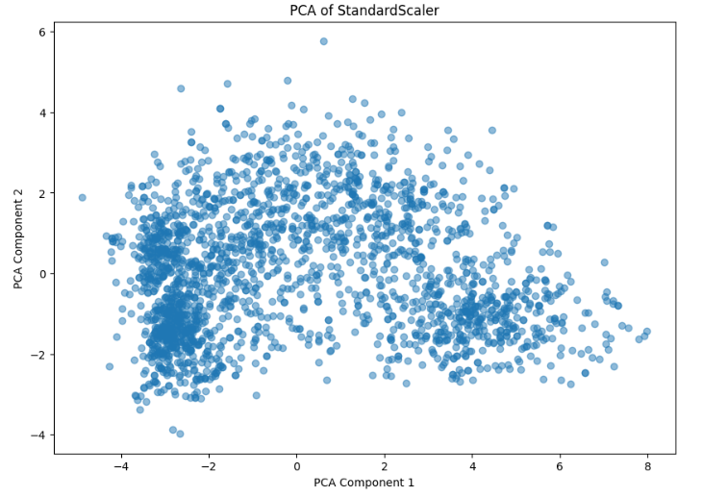
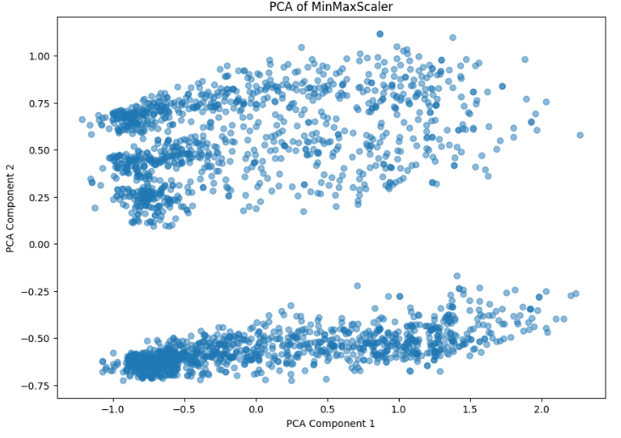
Data Preprocessing 1. used BOTH standard scaler AND MINMAX SCALER to bring the scale of the data at same level. 2. After that I used PCA for dimensionality reduction.

Slide 14
Clustering before hyperparameter tuning
For Standard Scaler data
For Min-Max data
Model | Silhouette Score
KMeans | 0.3976
Agglomerative | 0.3598
DBSCAN | 0.1518
Model | Silhouette Score
KMeans | 0.5719
Agglomerative | 0.5583
DBSCAN | 0.3589

Slide 15
Clustering After hyperparameter tuning
For Standard Scaler data
For Min-Max data
Model | Silhouette Score
KMeans | 0.5326
Agglomerative | 0.5148
DBSCAN | 0.3246
Model | Silhouette Score
KMeans | 0.5877
Agglomerative | 0.5753
DBSCAN | 0.3999

Slide 16
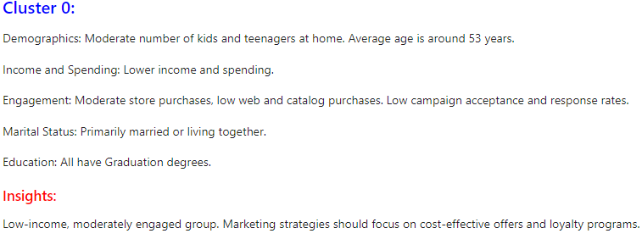
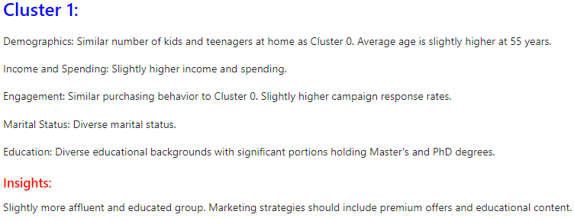
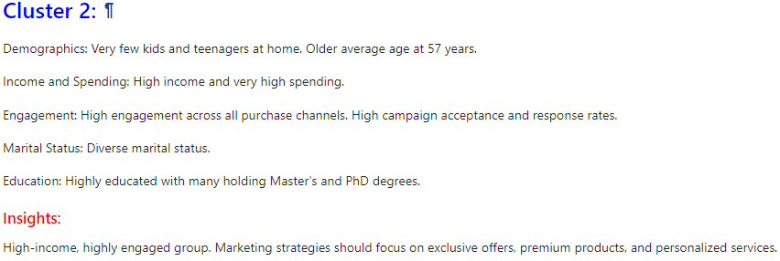
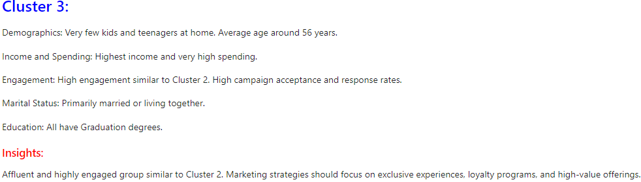
Clusters made by using kmeans algorithm

Slide 17
Overall Insights and information
Cluster 0: Focus on budget-friendly promotions and loyalty programs to encourage higher spending.
Cluster 1: Offer age-appropriate products and services, considering their slightly older demographic.
Cluster 2: Tailor premium and exclusive offers to maintain engagement and maximize their high spending potential.
Cluster 3: Enhance personalized experiences and high-end product offerings to match their affluent lifestyle and preferences.

Slide 18
Model Building for classification 1. used different classification models like logistic regression, Decision tree, random forest, support vector machine, knn, naïve bayes. 2. selected the best performing model based on different evaluation metrics like accuracy, precision, recall, f1 score.
Model | Accuracy | Recall | Precision | F1 score
Logistic Regression | 0.5436 | 0.5436 | 0.5581 | 0.5371
Decision Tree | 0.9620 | 0.9620 | 0.9630 | 0.9618
Random Forest | 0.9754 | 0.9754 | 0.9754 | 0.9754
Support Vector Machines | 0.4340 | 0.4340 | 0.2075 | 0.2792
K Nearest Neighbours | 0.5078 | 0.5078 | 0.5112 | 0.5112
Naïve Bayes | 0.9128 | 0.9128 | 0.9187 | 0.9130
From the above observations the best performing model is Random Forest Model. So my final model is Random Forest for classification of the new customers.

Slide 19
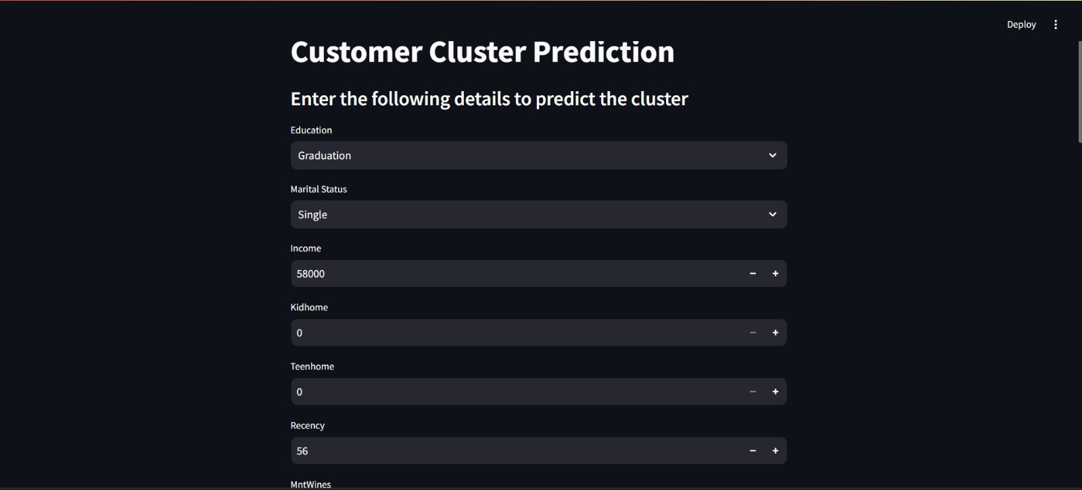
Model deployment using streamlit ScreenShots

Slide 20
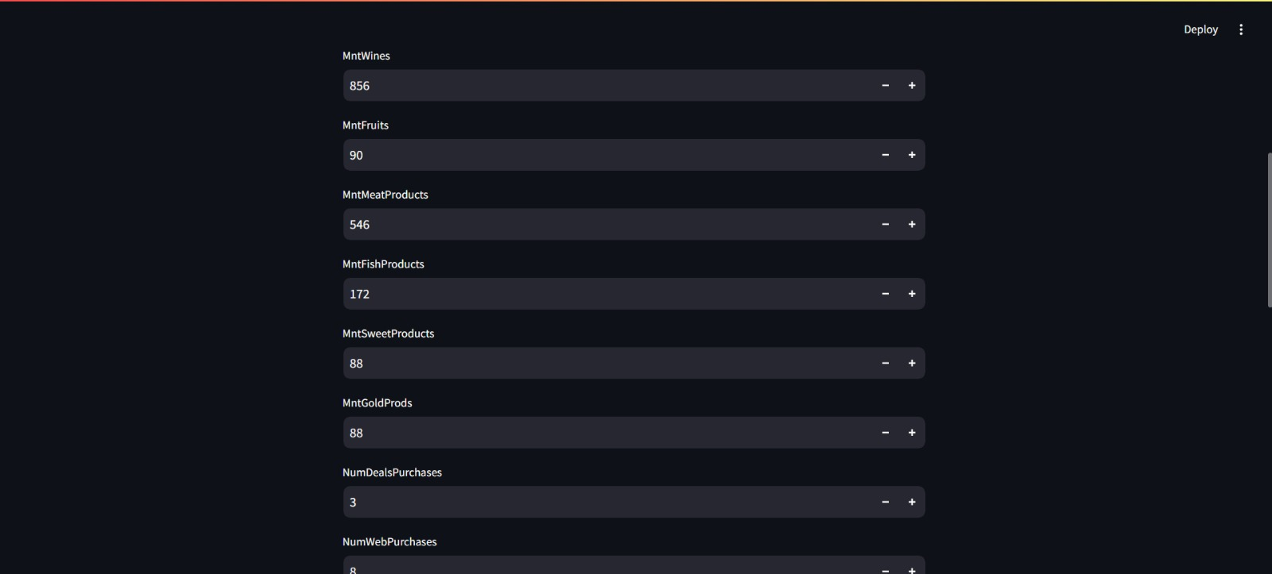

Slide 21
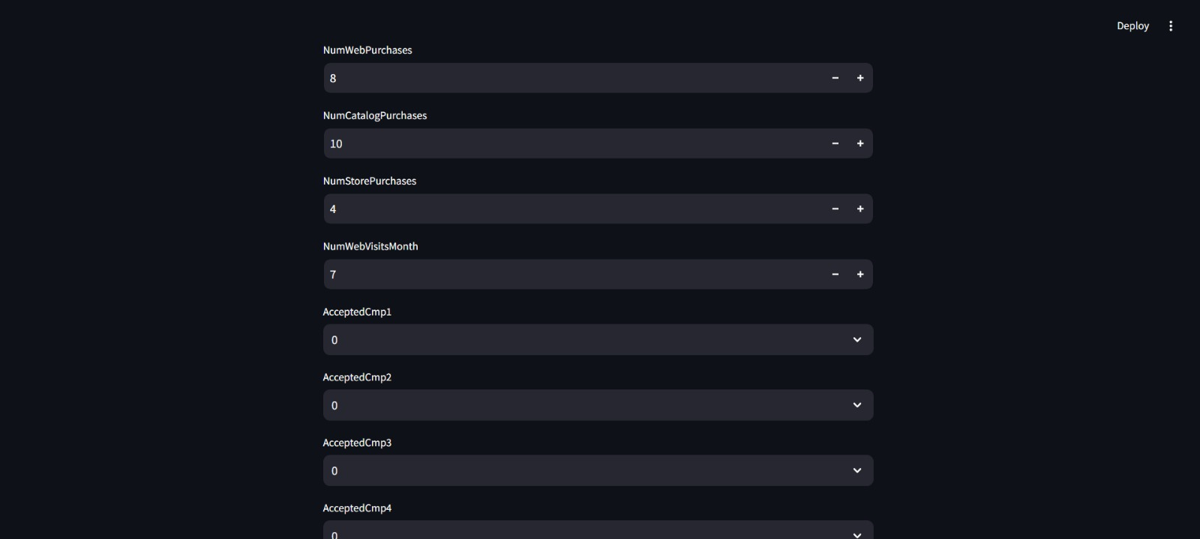

Slide 22
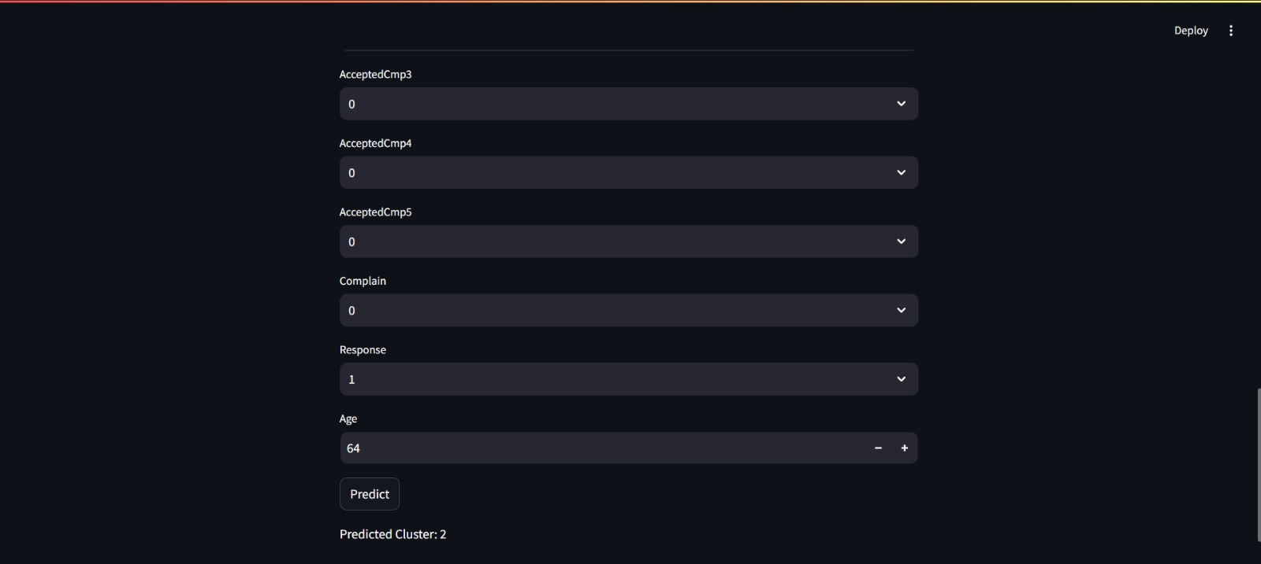

Slide 23
Challenges faced during project
The first challenge was the quality of the data. The data contained lots of outliers and also it was not normally distributed.
While data transformation I needed to take care of preserving the same information and insights.
The second challenge was to scale the data since the data consisted categorical and date-time columns.
The third challenge was to identify the target segments to analyze the customer data. By examining their demographics, purchasing behavior, preferences, and other relevant information.
Choosing the right clustering model was a challenging task because different clustering techniques interpreting different insights about the customers.

Slide 24
Thank you

